Slide 1



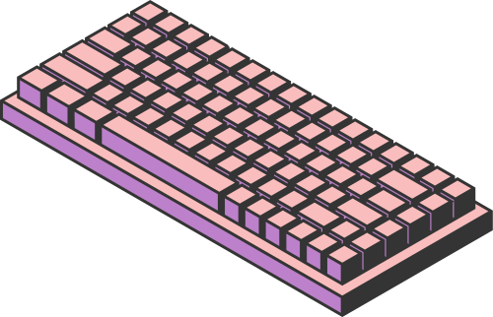
REAL-TIME PARKING OCCUPANCY ANALYTICS USING YOLO OBJECT DETECTION AND MONGODB REAL-TIME DATA PIPELINES
22MIA1094 - Anirudh R
22MIA1108 - Inesh S T
Submitted to Dr. Gayathri Devi S
Page 01

Slide 2

INTRODUCTION
Smart cities require efficient parking management systems to reduce congestion and fuel waste.
Computer Vision (CV)–based systems detect and monitor parking slots in real time.
NoSQL databases (like MongoDB) are ideal for handling high-frequency detection data, time-series analytics, and scalable storage.
This project focuses on optimizing MongoDB for real-time YOLO-based parking detection workload
Page 02

Slide 3


PROBLEM STATEMENT
Existing Smart Parking systems face performance bottlenecks when storing and analyzing high-volume CV data in real time.
Challenges include:
Inefficient schema design for YOLO detections (bounding boxes, confidence, timestamps).
Write–read tradeoffs under continuous data streams.
Lack of optimization for real-time queries in NoSQL systems.
Limited scalability for multi-camera environments.
Page 03

Slide 4

RESEARCH OBJECTIVES
Design and validate an optimized schema for CV-based parking data in MongoDB.
Compare different indexing strategies to balance write speed and query performance.
Evaluate aggregation pipeline performance for real-time analytics.
Simulate scalability with multiple camera feeds and varying loads.
Develop a real-time dashboard that reflects occupancy using optimized MongoDB queries.
Page 04

Slide 5

LITERATURE REVIEW
Theme 1: NoSQL Performance for Real-Time Data
Cooper et al. (2010) introduced YCSB benchmark for evaluating NoSQL systems.
Abramova et al. (2014) compared NoSQL databases for large-scale analytics workloads.
Davoudian et al. (2018) reviewed data models and scalability patterns in NoSQL systems.
Theme 2: Smart Parking Architectures
Rizvi et al. (2018) surveyed IoT-integrated smart parking models.
Vlahogianni et al. (2016) proposed real-time parking prediction systems for smart cities.
Theme 3: Computer Vision in Parking Systems
Redmon et al. (2016) introduced YOLO for real-time object detection.
Kianpisheh et al. (2012) designed ultrasonic-based Smart Parking architecture.
Recent works combine CV + cloud databases but lack MongoDB optimization focus.
Identified Gaps:
No existing study quantifies MongoDB optimization impact for CV workloads.
Schema–index co-design for real-time object detection data is unexplored.
Performance trade-offs between sharding and time-series ingestion not addressed.
Page 05

Slide 6
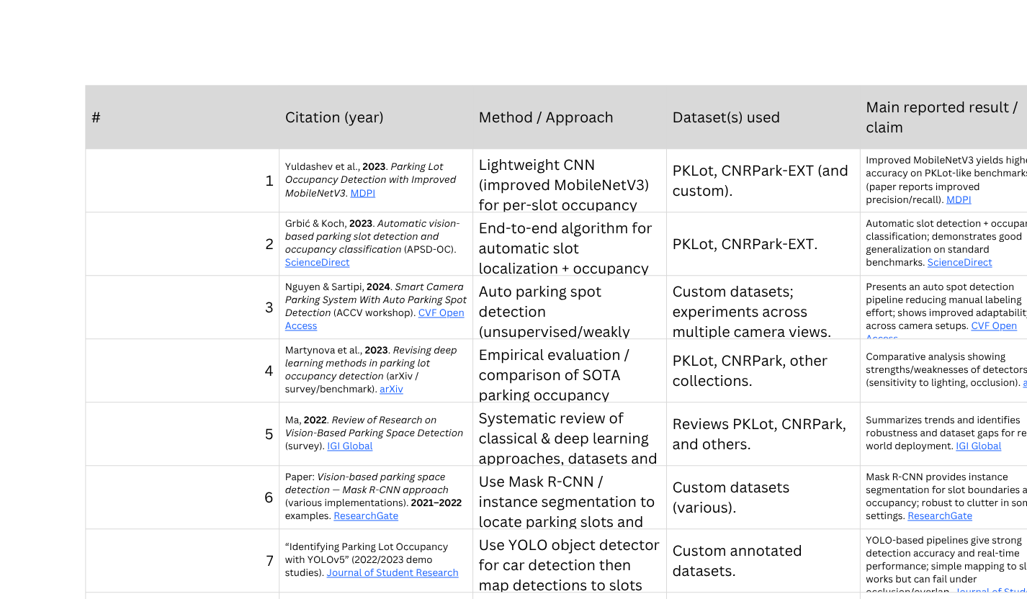
LITERATURE REVIEW
Page 06

Slide 7
PROPOSED SYSTEMS - INTRODUCTION
A real-time Smart Parking system that:
Detects occupancy using CV (YOLO/OpenCV).
Sends real-time updates to a Flask backend.
Stores logs and historical data in MongoDB.
Displays availability on a live dashboard.
Page 07

Slide 8
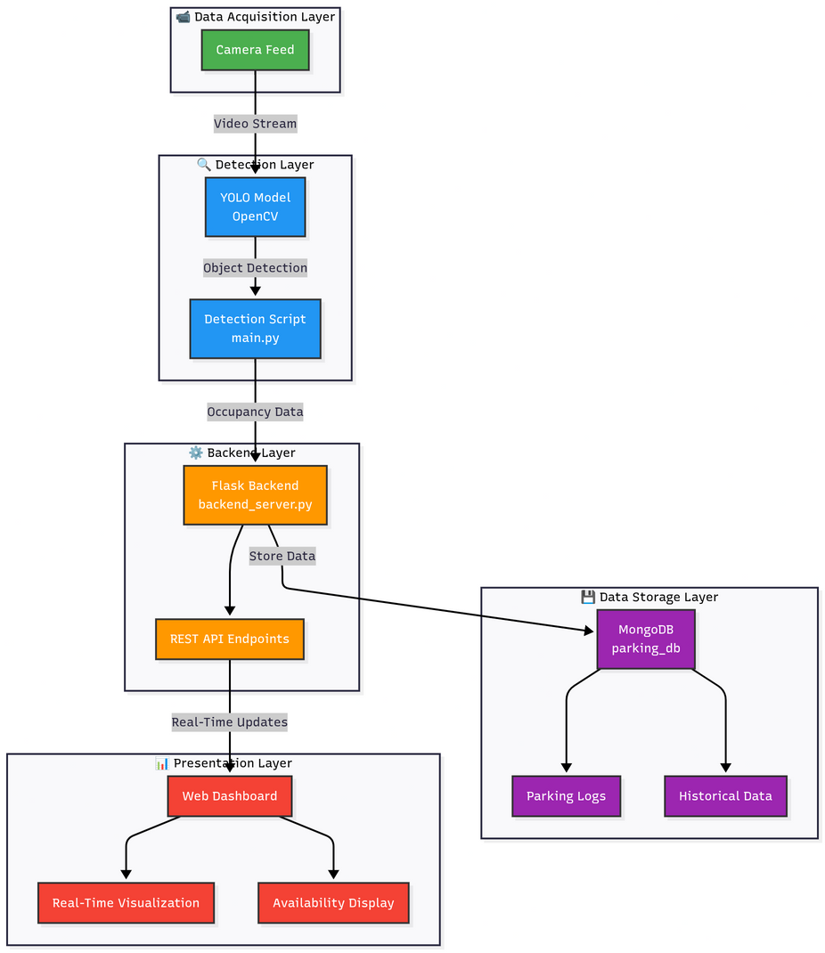
PROPOSED SYSTEMS - DIAGRAM
Phase 1: Baseline System
Implement a "naive" system with default settings to establish baseline performance metrics.
Phase 2: Iterative Optimization & Benchmarking
Systematically test and measure the impact of different schema, indexing, and aggregation strategies.
Phase 3: Scalability Testing
Simulate increased load (more cameras, more users) to evaluate performance and test sharding.
Workload Simulation
Use Python scripts to mimic high-frequency writes (from YOLO) and concurrent reads (from mobile apps).
Page 08

Slide 9

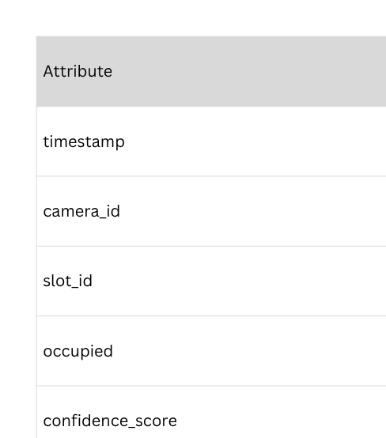

PROPOSED SYSTEMS - DATASET SNAPSHOT
Page 09

Slide 10
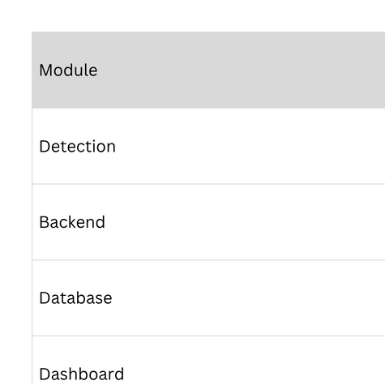
PROPOSED SYSTEMS - LIST OF MODULES
Detection Module (main.py) – Reads live feed, classifies occupancy per slot.
Backend Module (backend_server.py) – REST API, handles data ingestion and queries.
Database Module (MongoDB) – Stores logs, real-time occupancy, metadata.
Frontend Module (Dashboard) – Displays real-time occupancy status and stats.
Analytics Module – Performs aggregation queries (availability trends, peak hours).
Page 10

Slide 11
IMPLEMENTATION (60%) CONTD.
Modules Completed:
Parking slot detection with video feed.
Flask backend with MongoDB connection.
Working web dashboard at localhost:8000.
Page 11

Slide 12
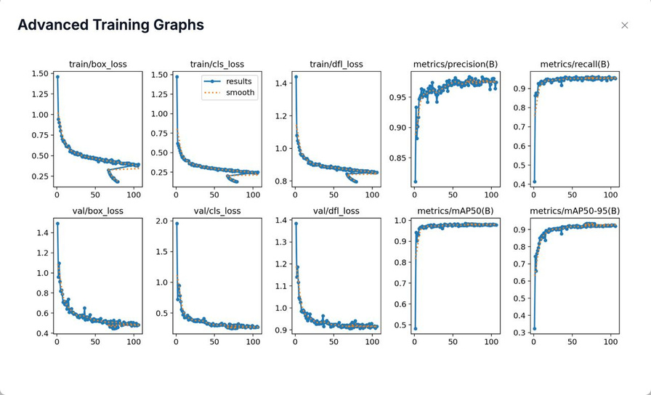
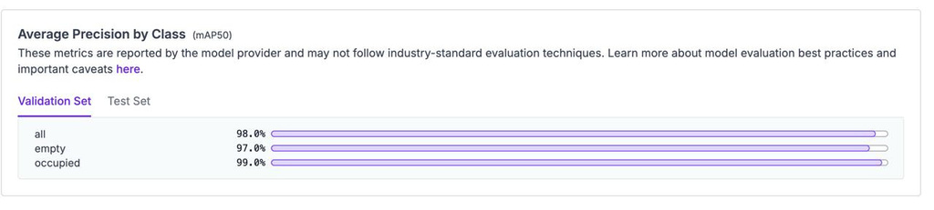
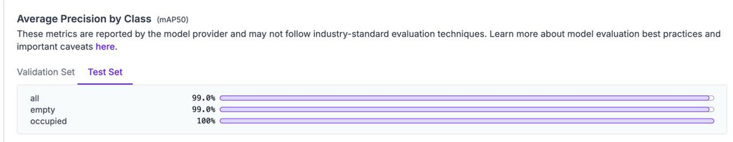
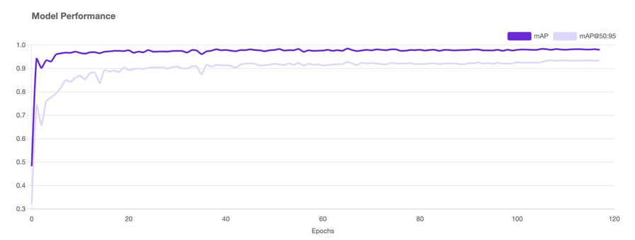
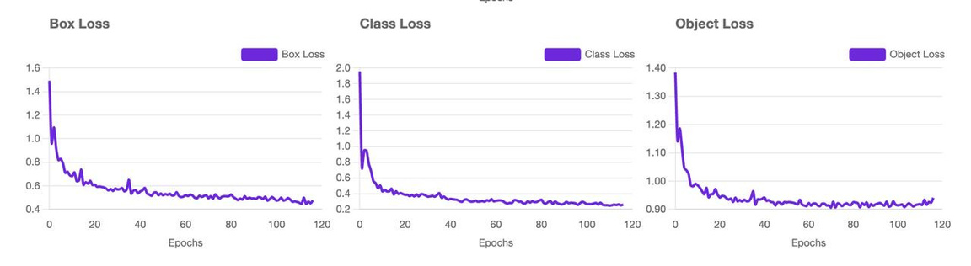
IMPLEMENTATION (60%) CONTD.
Results :
Page 12

Slide 13
IMPLEMENTATION (60%) CONTD.
WHAT IS TO BE DONE NEXT
Integrate YOLOv11 / CNN model for improved slot-level accuracy.
Improve the live availability frontend.
Evaluate scalability with multi-camera sharding.
Compare MongoDB vs other NoSQL databases (Cassandra, Redis).
Page 13

Slide 14
RESEARCH PAPER STATUS
Tentative Paper Title:
“Optimized Real-Time Smart Parking Occupancy Detection Using YOLOv11 and MongoDB”
Target Conference:
IEEE ICCCNT / ICACCS / Springer SmartCom / Scopus Indexed IoT Journals
Status:
Literature review completed (8 papers)
Experimental setup running (60% done)
Results under evaluation
Draft writing in progress
Page 14

Slide 15
REFERENCES
Cooper, B.F., et al. “Benchmarking cloud serving systems with YCSB.” ACM SoCC, 2010.
Abramova, V., Bernardino, J. “Which NoSQL database? A performance overview.” OJoDB, 2014.
Davoudian, A., et al. “A survey on NoSQL stores.” ACM Computing Surveys, 2018.
Redmon, J., et al. “You Only Look Once: Unified, Real-Time Object Detection.” CVPR, 2016.
Vlahogianni, E.I., et al. “A real-time parking prediction system for smart cities.” JITS, 2016.
Rizvi, S.R., et al. “A survey on the role of IoT in smart parking systems.” Computer Networks, 2018.
Cattell, R. “Scalable SQL and NoSQL data stores.” ACM SIGMOD Record, 2011.
Lakshman, A., & Malik, P. “Cassandra: A decentralized structured storage system.” ACM, 2010.
Page 15

Slide 16
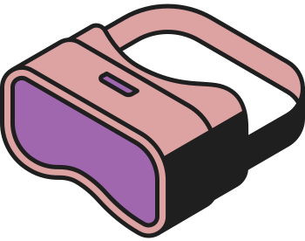



THANK YOU
Page 16

